Slide 1
Week 5 – lesson 1

Slide 2
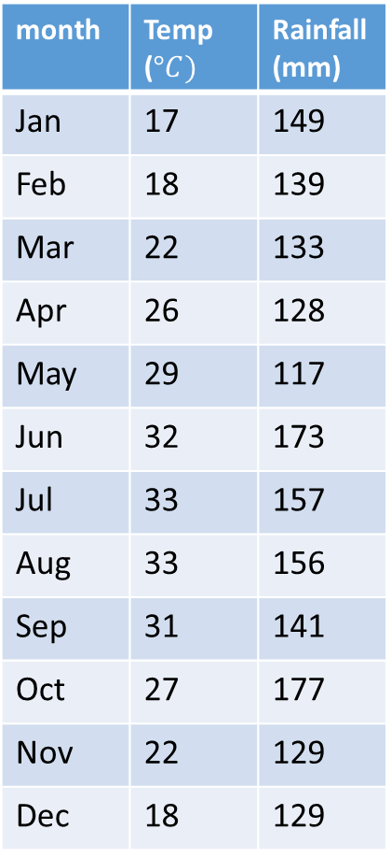

EQ: How can graphs be used in everyday life?
TOPIC: Graphs
month | Temp ($°C)$ | Rainfall (mm)
Jan | 17 | 149
Feb | 18 | 139
Mar | 22 | 133
Apr | 26 | 128
May | 29 | 117
Jun | 32 | 173
Jul | 33 | 157
Aug | 33 | 156
Sep | 31 | 141
Oct | 27 | 177
Nov | 22 | 129
Dec | 18 | 129
A climate graph combines temperature and rainfall information.
Temperature ($°C)$
Rainfall mm
Months

Slide 3
Week 5 – lesson 2

Slide 4
Mathematical Thinking Process Planning Sheet
Interpret the task
Identify the mathematics involved
Analyse information/data (you may need to use other sources)
Apply existing mathematical knowledge and strategies
Verify the reasonableness of your answer

Slide 5
Week 5 – lesson 3

Slide 6
Week 5 – lesson 4

